Slide 1


Welcome all ☺

Slide 2



Write back on LIVE “Power BI” dashboard with “PowerApps”

Slide 3


About me
Dheeraj Tuteja Sr. Power BI Developer at COWI, Lyngby, Denmark
Power BI [PL-300] | Azure Enterprise Data Analyst Associate [DP-500] | DAX | TSQL | Python | Azure Data Engineer | Azure Synapse | Azure Databricks | Azure Data Factory | PowerApps | VBA | Excel | SCRUM [PSM 1]

Slide 4

Teaser ☺

Slide 5

Use case
Always start with WHY ☺
Comments / Feedback from the end users.

Slide 6

Real case study
Two scenarios

Slide 7
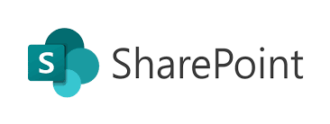
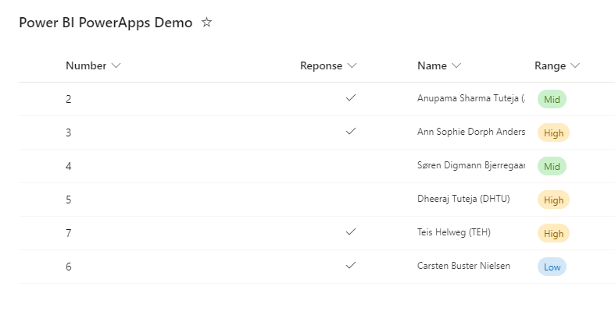
Case 1 : With SharePoint List / Excel
SharePoint List
Disadvantage:
Sharepoint List / Excel are cannot be connected as Direct Query in Power BI.
Create, Read, Update, and Delete (CRUD) operations are NOT live.
This implies Excel Import Mode to be refreshed to see the changes done by the PowerApps.

Slide 8

Case 2 : With Azure SQL Table
DIRECT QUERY
Azure SQL Table
Advantages:
Azure SQL can be connected as Direct Query in Power BI.
Create, Read, Update, and Delete (CRUD) operations are LIVE.
Power BI visuals are refreshed by the PowerApps.

Slide 9
Case 2: Application architecture
Direct Query
PowerBIIntegration Dataset
Screen 1
(Pivot)
R, D
Screen 2
(Executor)
Azure SQL Table
C (New Mode)
U (Edit Mode)
PowerBIIntegration.Refresh()

Slide 10

Prerequisites
Azure SQL Table with a Primary Key. This table is to be used as a basis to make visuals in Power BI. PowerApps need a Primary Key to generate form layout fields.
Power BI connected to Azure SQL in DIRECT QUERY mode.
Good working knowledge of PowerApps and Power BI.

Slide 11
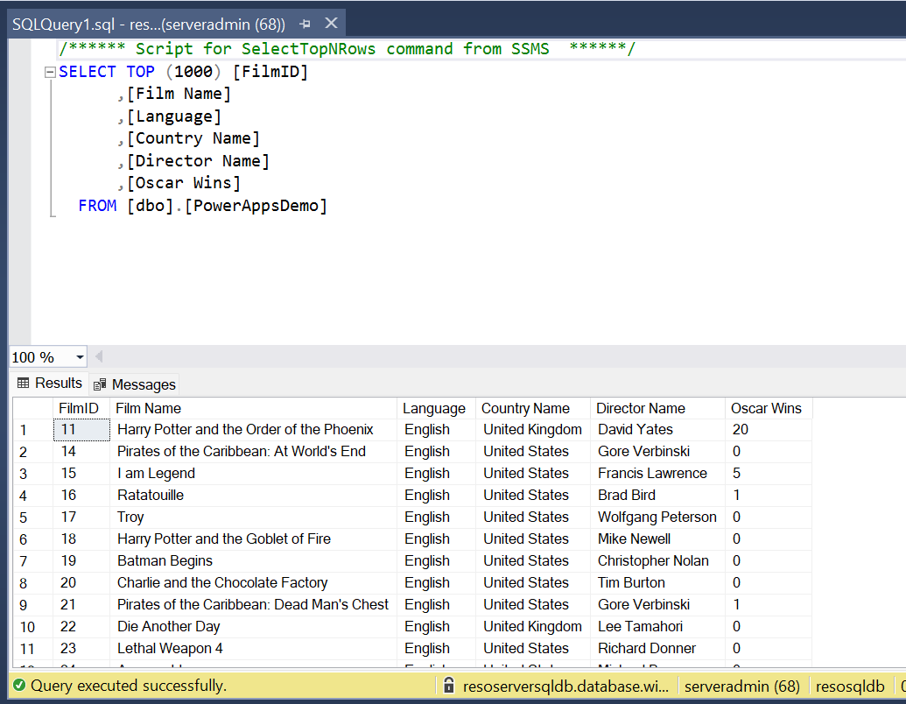
Prerequisites
I have used Movies database for this demo. (Table : PowerAppsDemo)

Slide 12

Let’s begin ☺

Slide 13
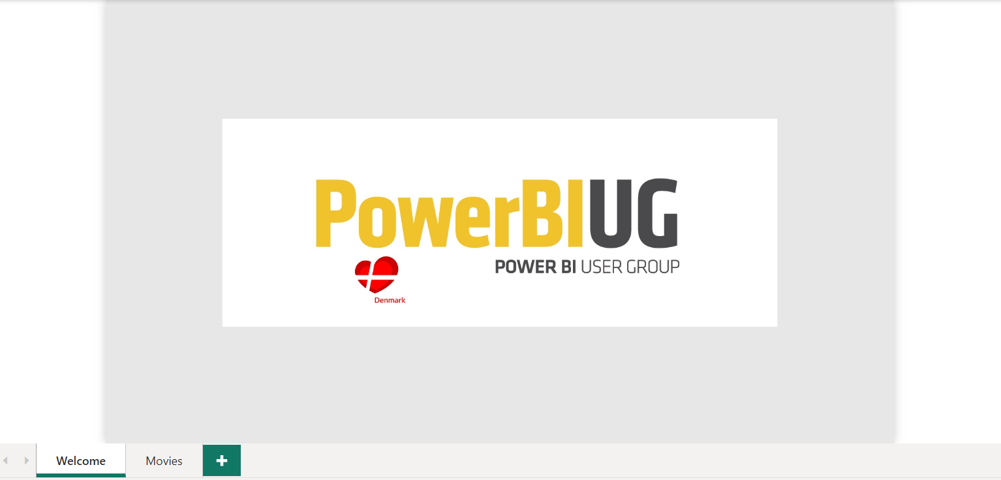
Step 1: Finish the dashboard on the Power BI desktop and publish one Power BI service. In my case, I have a premium workspace as my sandbox.

Slide 14
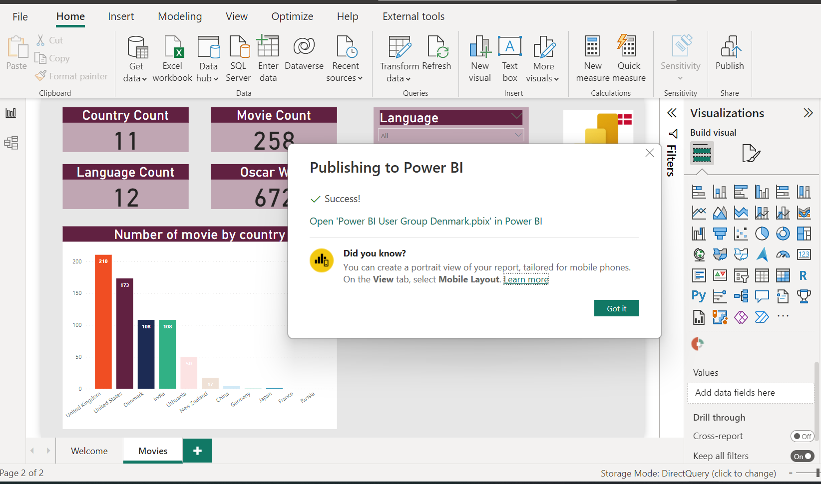
Step 1: ..continued.

Slide 15
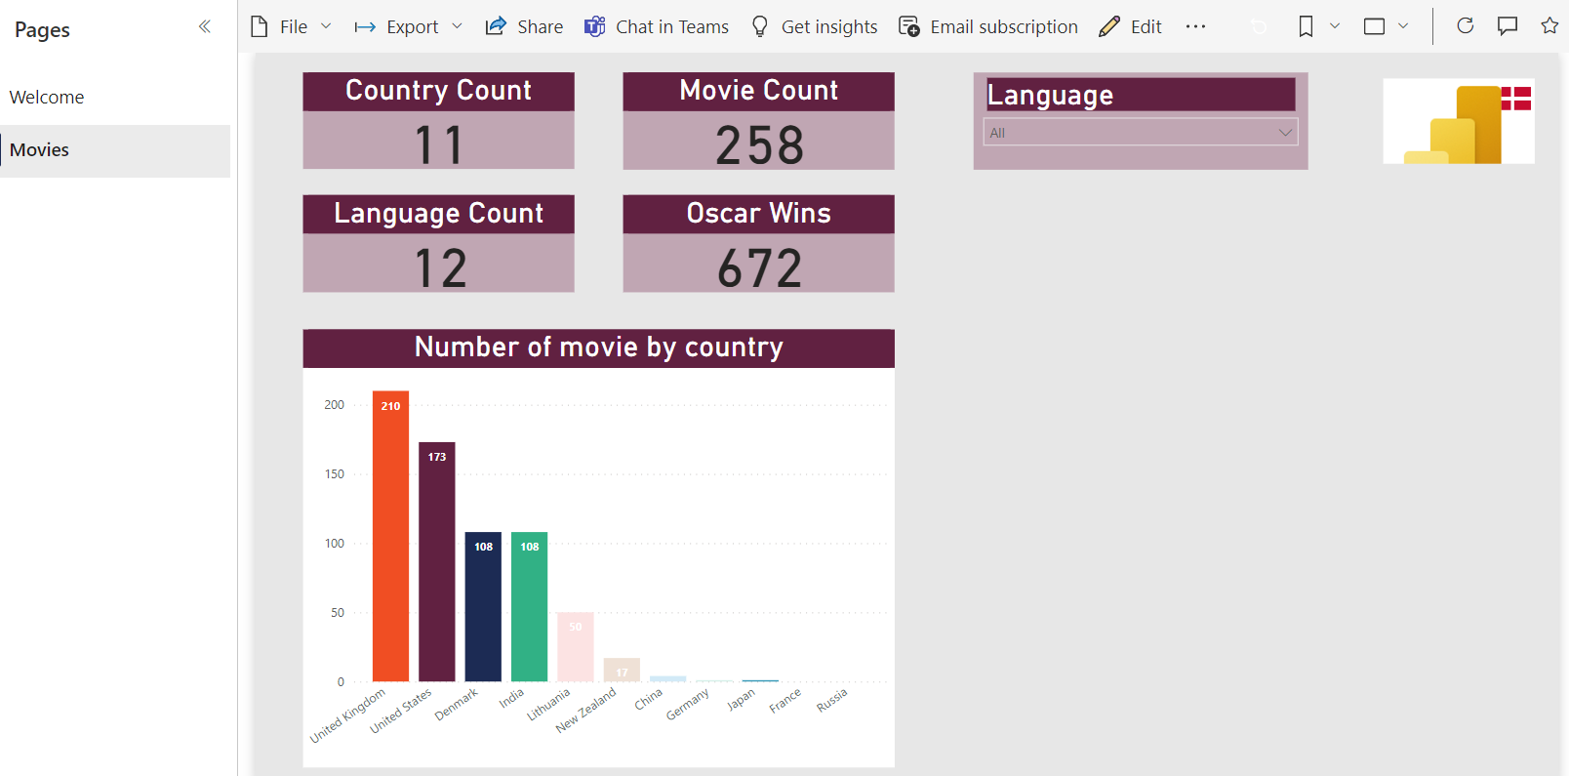
Step 2: In Power BI Service, open the report and click the Edit button (at the Top).

Slide 16
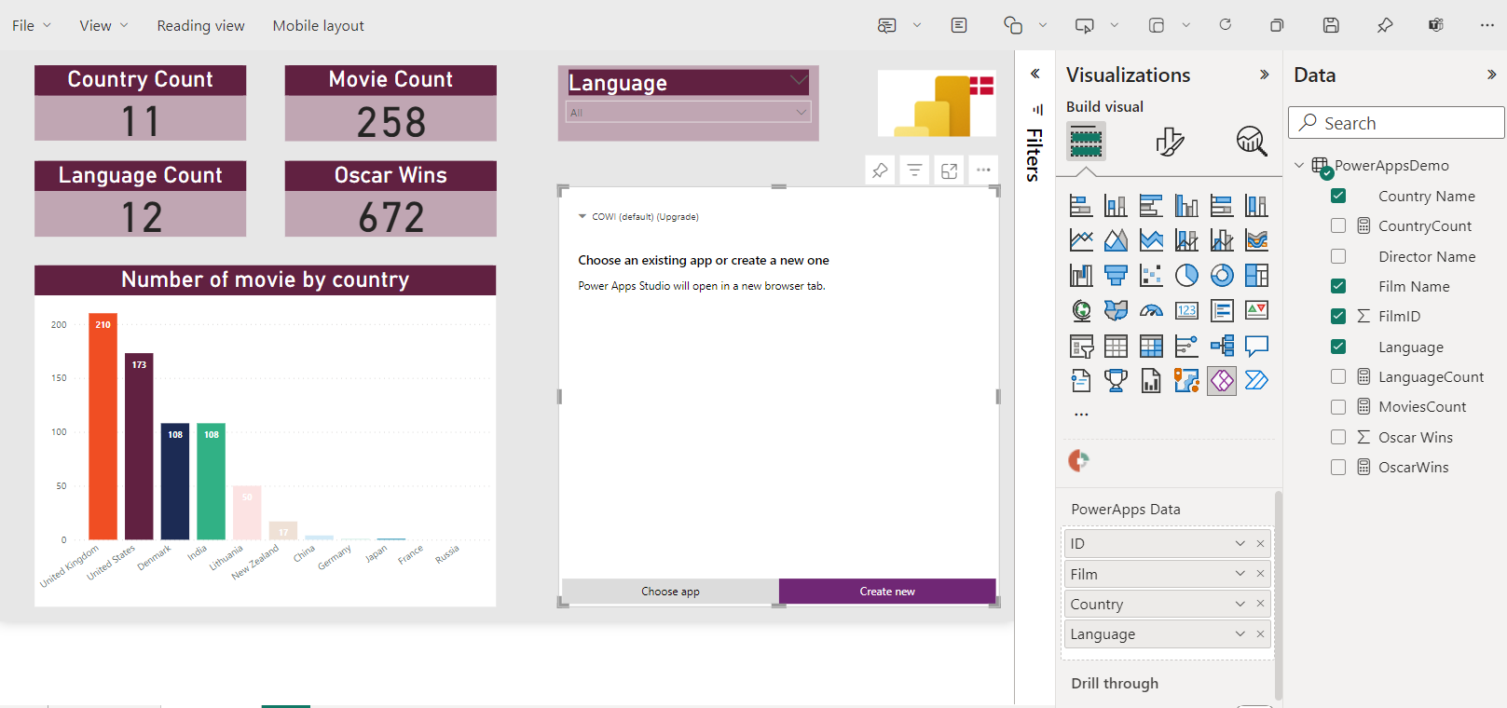
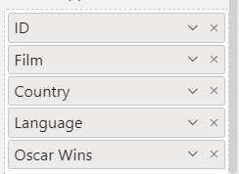
Step 3: Add PowerApps visual and drag the relevant columns from your dataset in the values section.

Slide 17
Step 4: As soon as you add columns in the tables section, you will see this 👇. Just click on "Create New".

Slide 18
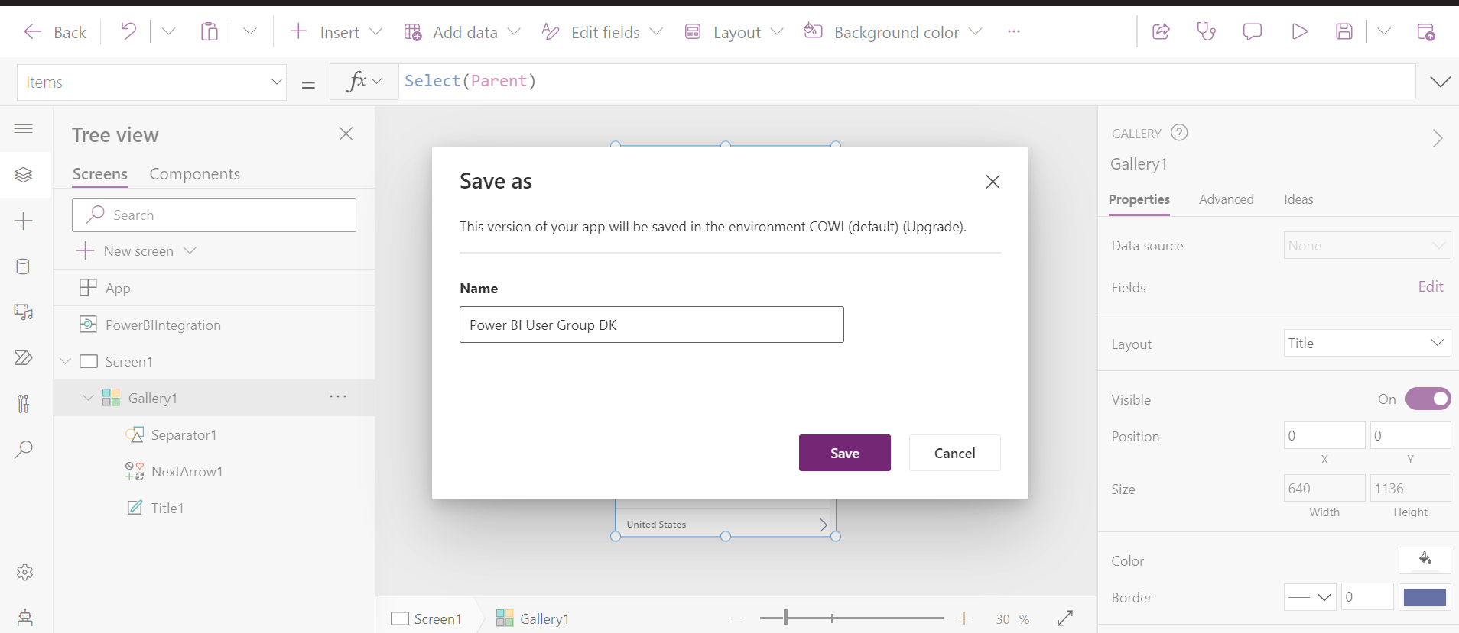
Step 5: You will be taken to PowerApps screen. Its always a good idea to name the app and Save.

Slide 19
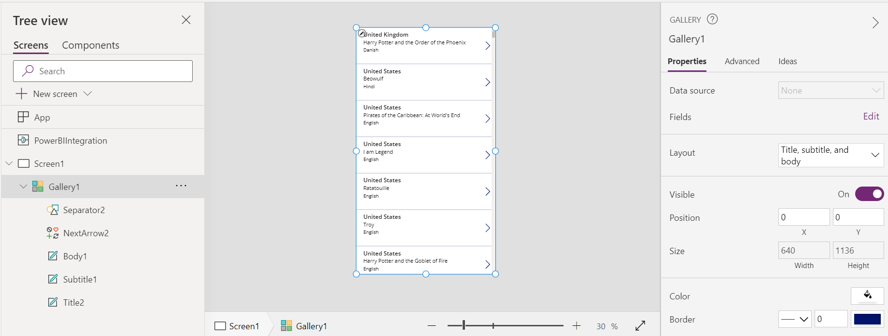
Step 6: Under Screen1, select Gallery1, and change the layout to - "Title, subtitle, and body"

Slide 20
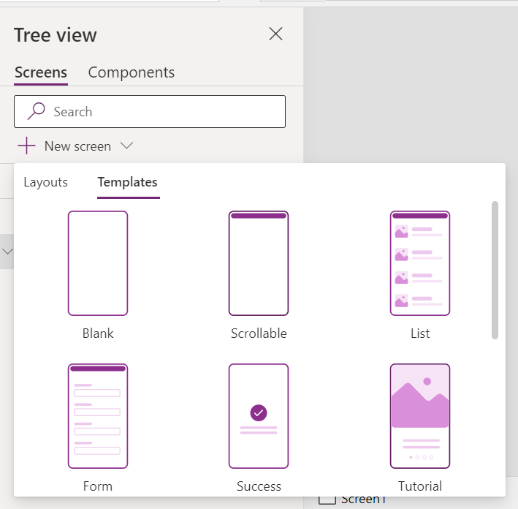
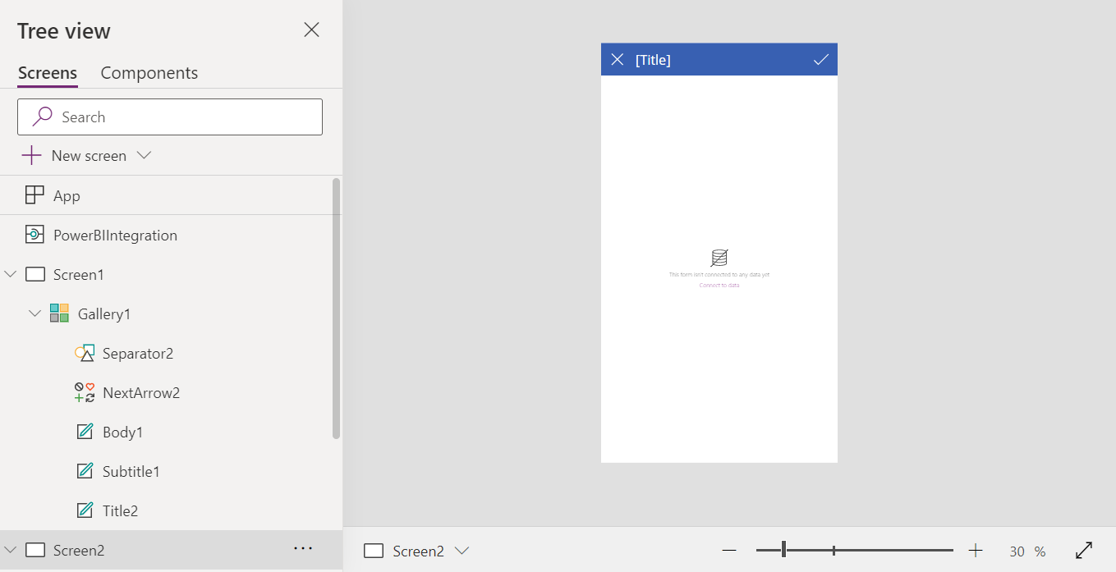
Step 7: Click New Screen - Templates - Form. Now you have Screen2 added.

Slide 21
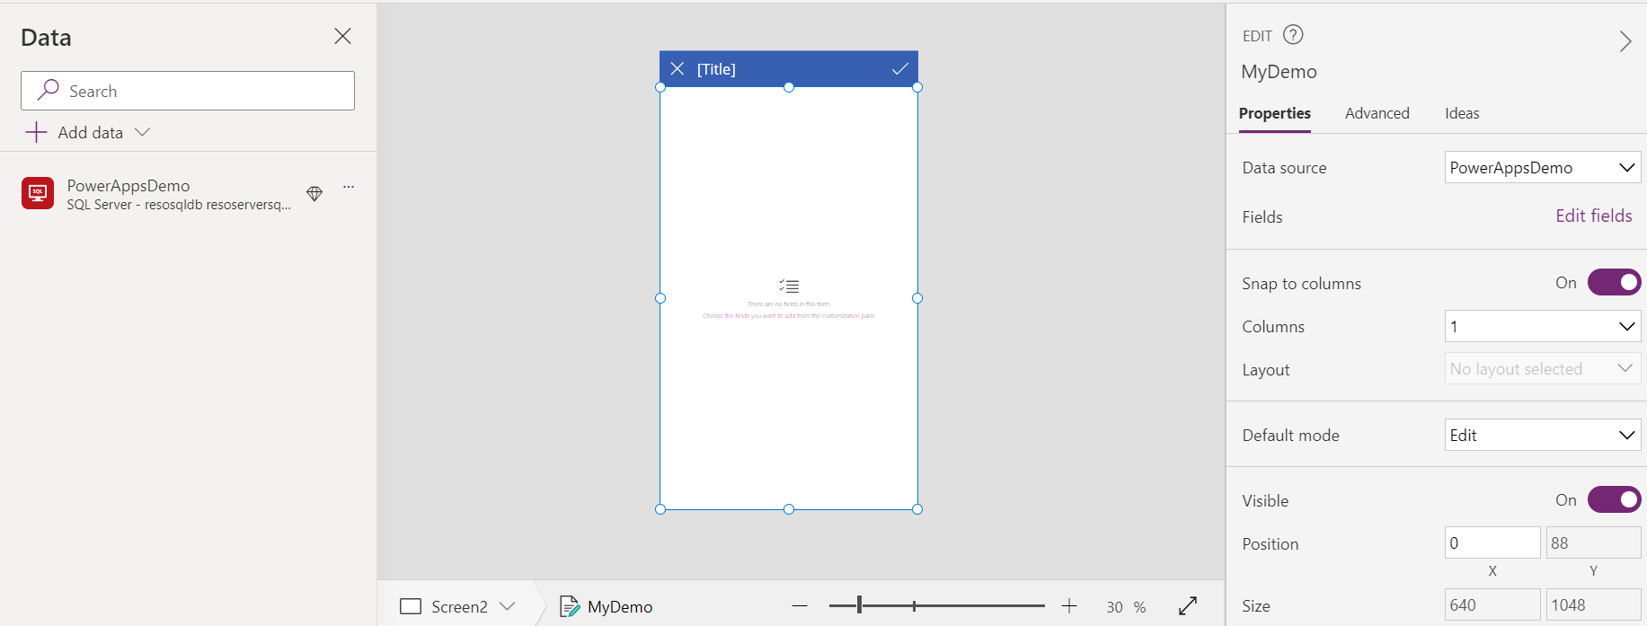
Step 8: Connect Screen2 to the Azure SQL Database and select the relevant table and fields. Just observe Screen2 has an EditForm. Rename this to MyDemo.

Slide 22
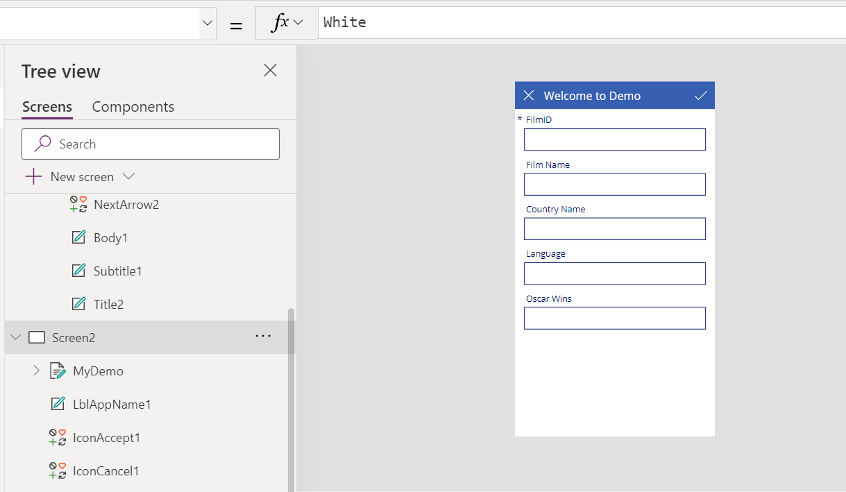
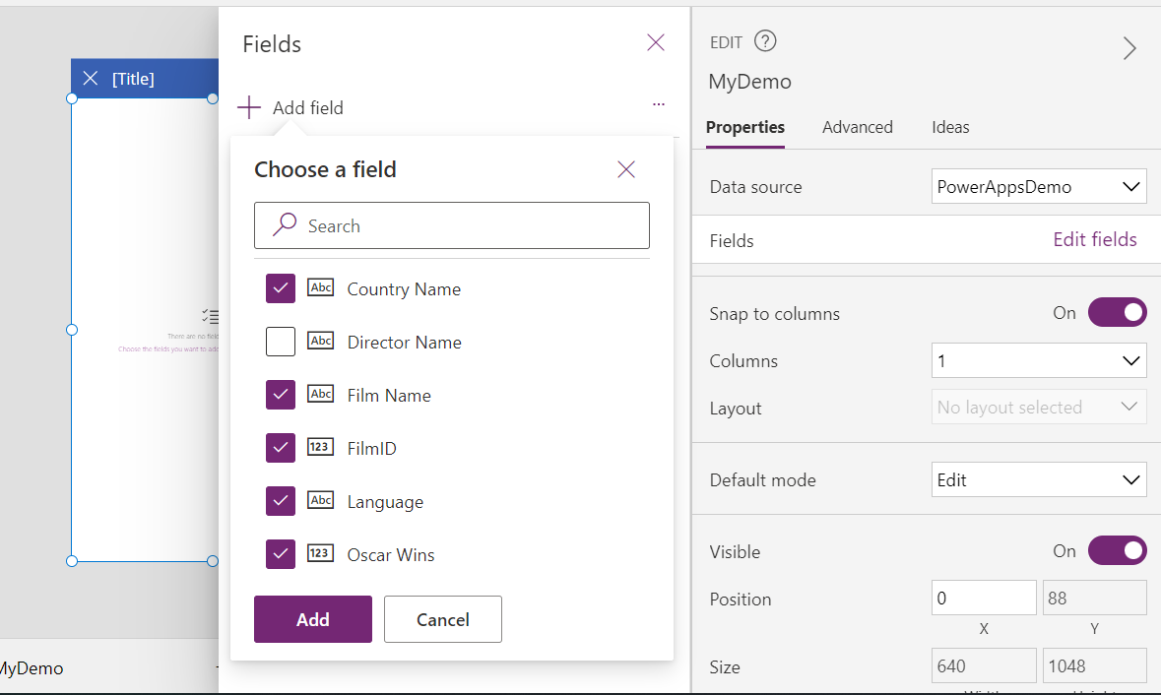
Step 9: Click Edit Fields and add relevant columns from SQL table (To be shown on PowerApps form control).

Slide 23
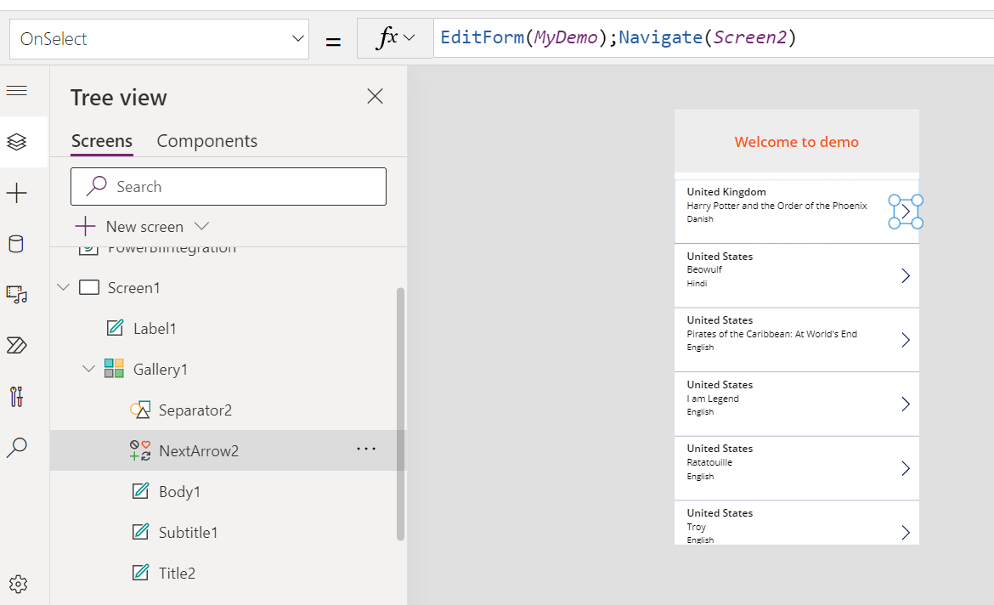
Step 10 : Now go to Screen1 - Gallery1 - NextArrow and choose OnSelect property and paste this code in blue → EditForm(MyDemo);Navigate(Screen2)

Slide 24
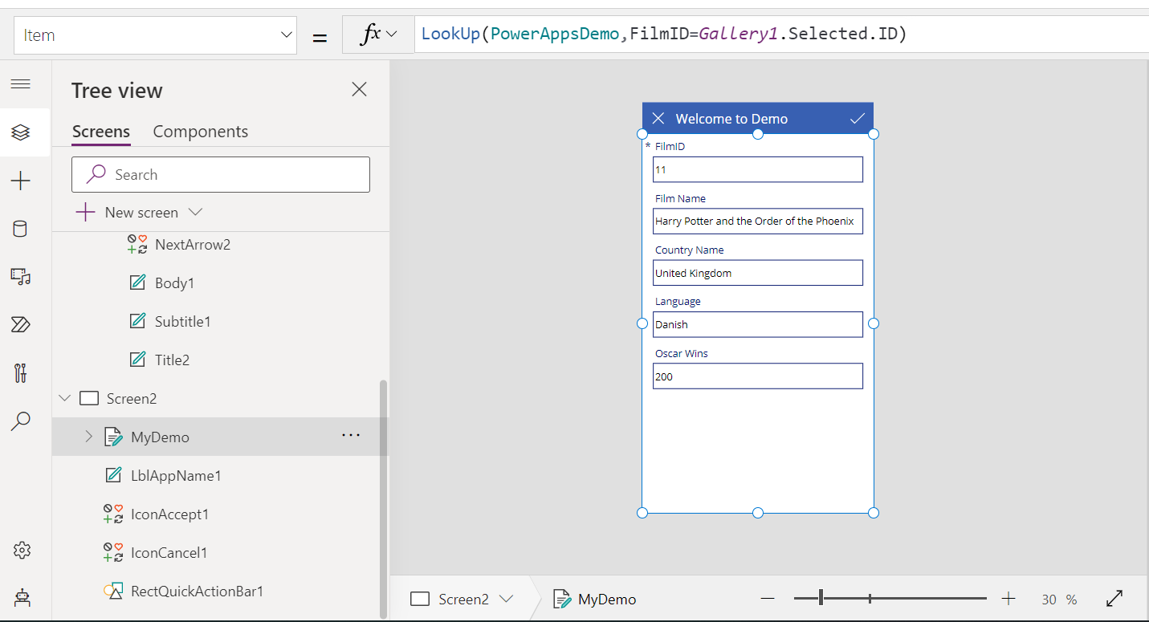
Step 11: Now, any value selected on Screen1 should filter Screen2 i.e., selection from Screen1 should pass to Screen2. Click Screen2 → MyDemo → Item Property and paste the code in blue : LookUp(PowerAppsDemo,ID=Gallery1.Selected.ID)

Slide 25
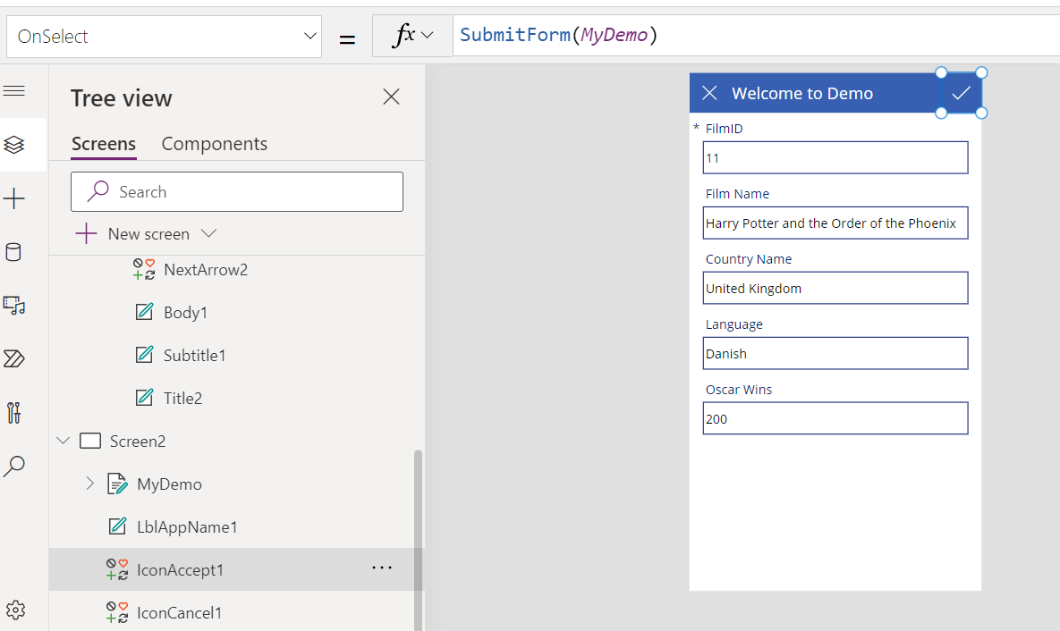
Step 12: . Click Screen2 → Click ✔️ → OnSelect Property and paste the code in blue: SubmitForm('MyDemo')

Slide 26
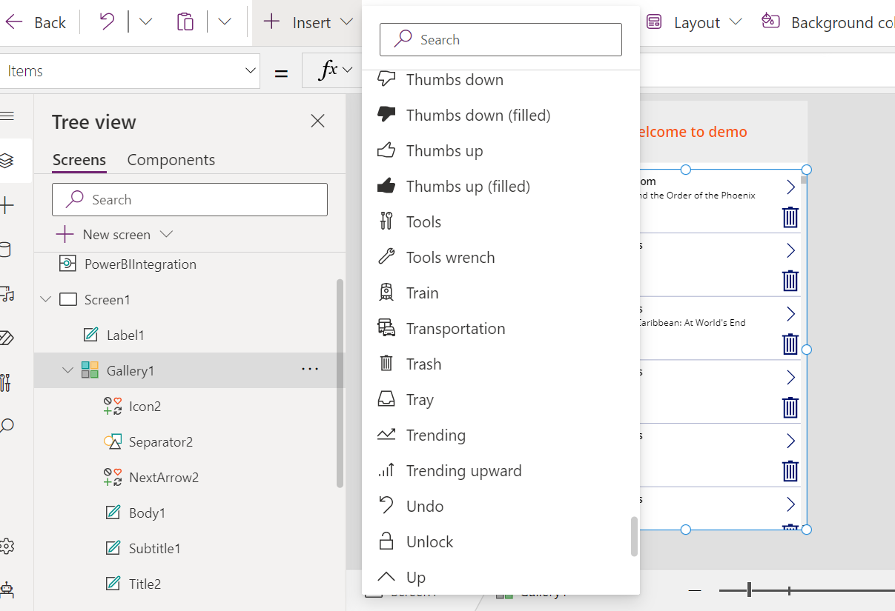
Step 13: Insert Trash icon on 🗑 (Delete) on Screen1 - Gallery 1

Slide 27
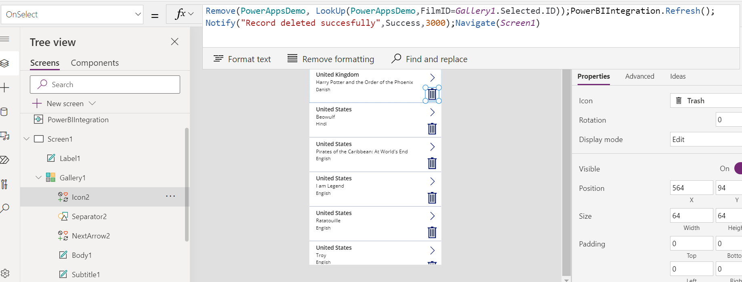
Step 14: Go to OnSelect property of 🗑 and paste the code in blue: Remove(PowerAppsDemo,LookUp(PowerAppsDemo,FilmID=Gallery1.Selected.ID));PowerBIIntegration.Refresh();Notify("Record deleted succesfully",NotificationType.Success,3000);Navigate(Screen1)

Slide 28
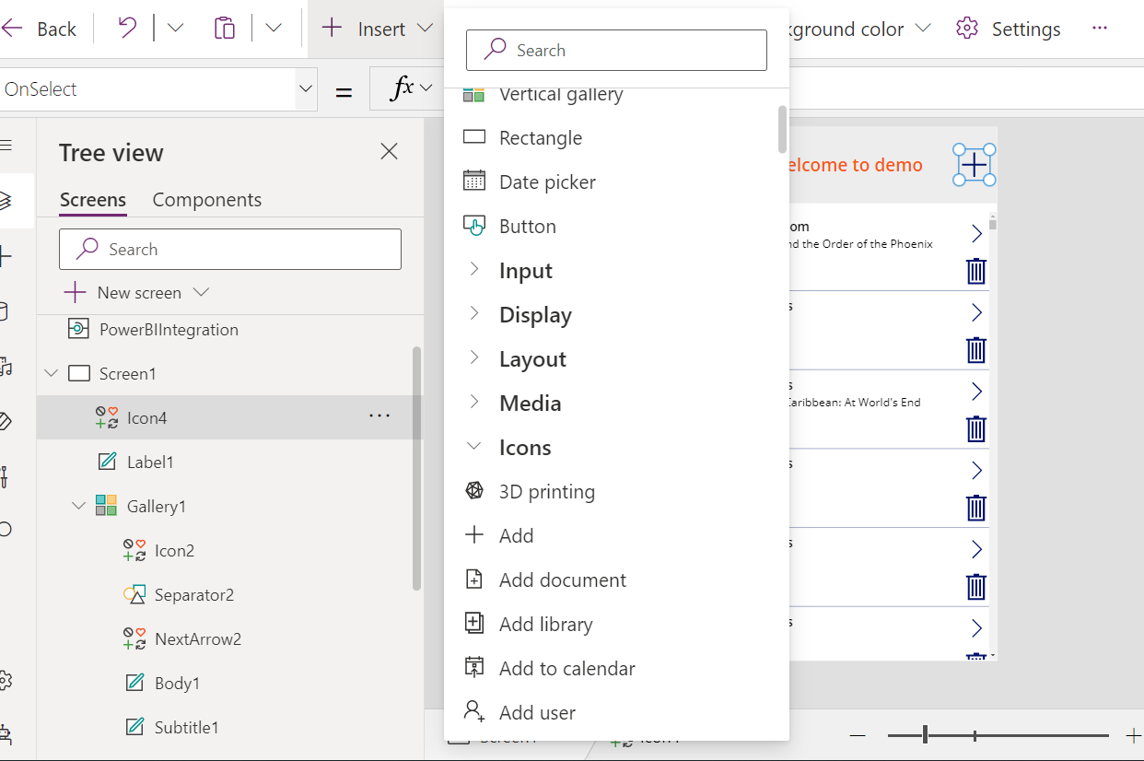
Step 15: Add ✖️ icon on Screen1 header.

Slide 29
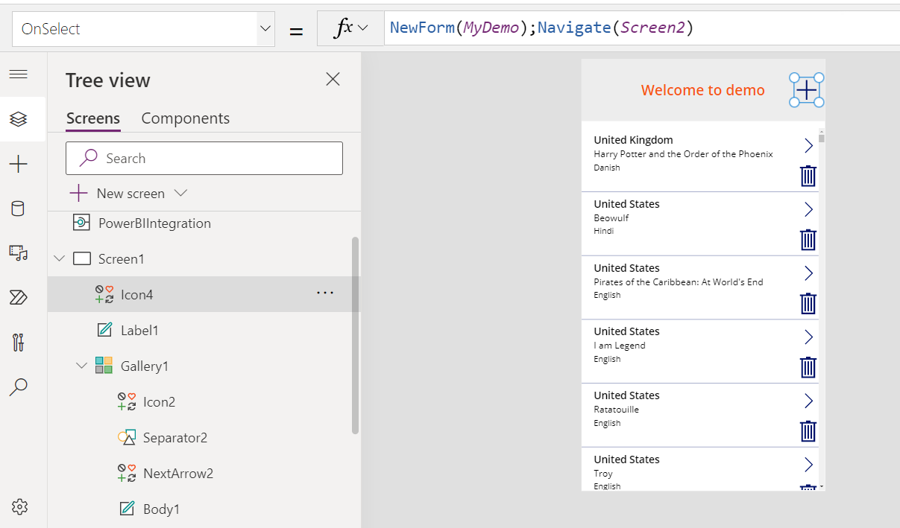
Step 16: Go to OnSelect property of ✖️ and paste the code:

Slide 30
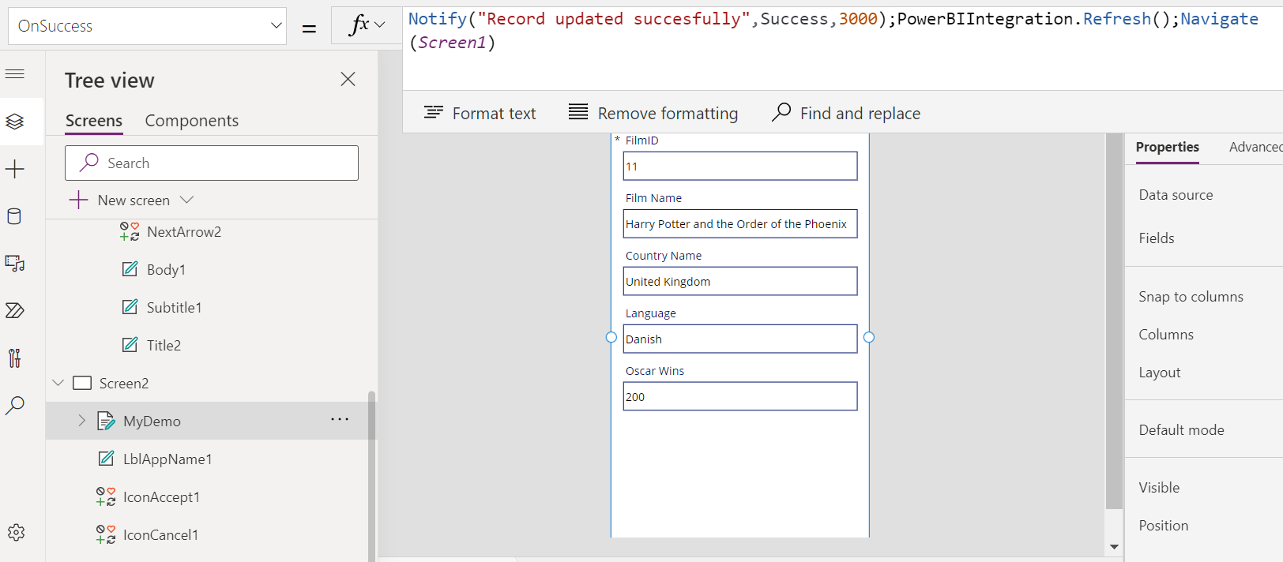
Step 17: Click Screen2 → MyDemo → OnSuccess property and paste this code in blue: Notify("Record updated succesfully",NotificationType.Success,3000);PowerBIIntegration.Refresh();Navigate(Screen1)

Slide 31
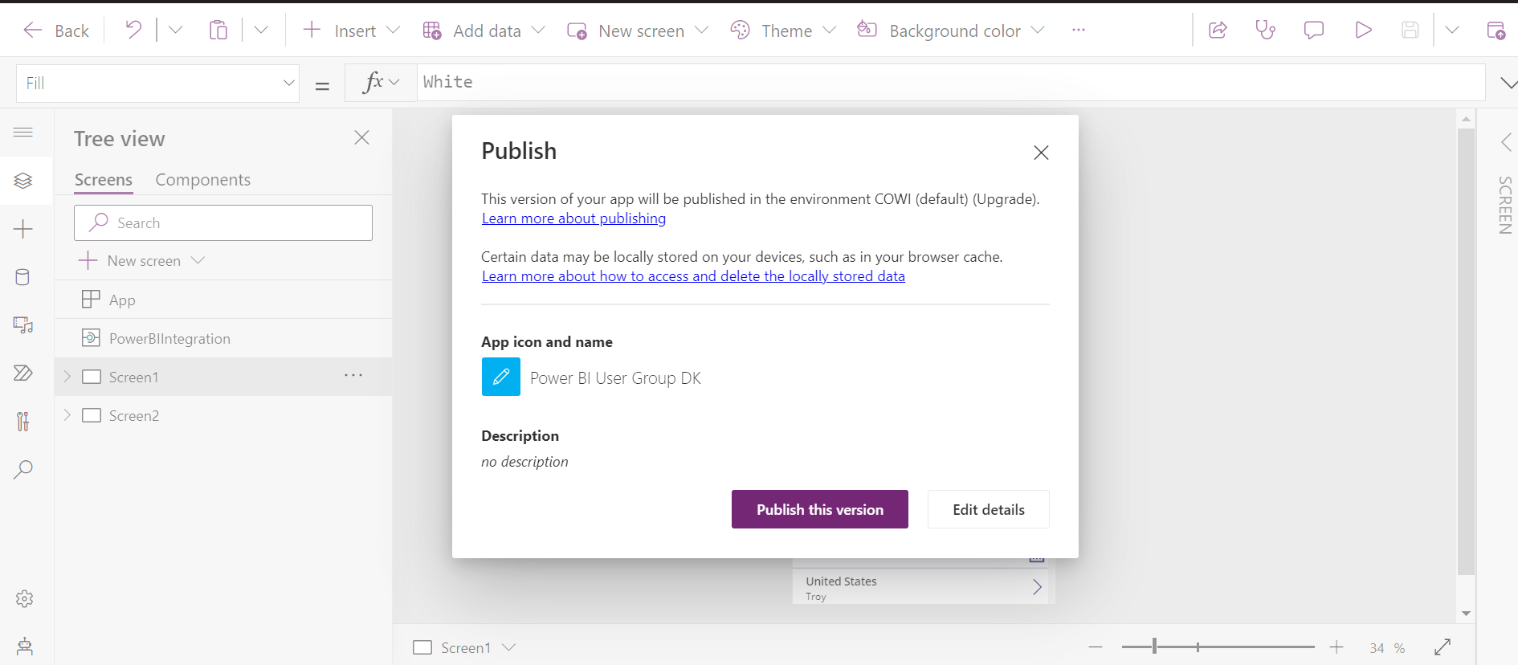
Step 18: Save and publish the PowerApps. Return to Power BI report and Save and Refresh.

Slide 32


Happy learning ☺
Follow for more. Stay tuned!

